Slide 1
Real&Fake News Classifier
Xiaoxuan Xiang

Slide 2

Introduction
News posts have to be checked for their authenticity, since spreading misinformation has been a real concern in today’s times.
Manual classification of news is tedious and time-consuming and is also subject to bias. Therefore, this project aims to build a model to execute an automatic classification of real&fake news.

Slide 3
Dataset Introduction
title: the title of the articles
text: the text of articles
title without stopword: title with stopword removed
text without stopword: text with stopword removed
language: language of articles
site_url: URL of articles sources
type: type of news
hasImage: whether this news published with an image
author: author of articles (not focused)
published: published time(not focused)

Slide 4
1.Data check

Slide 5
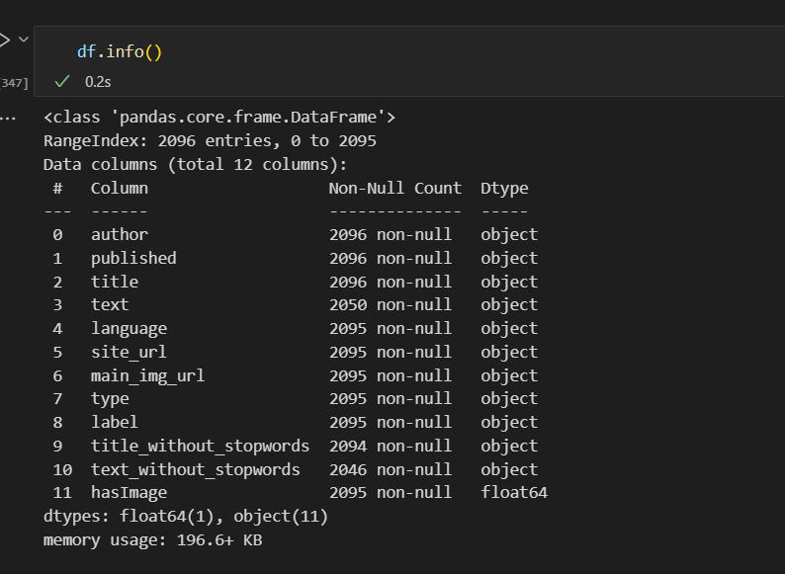
Data check
Imbalanced Data

Slide 6
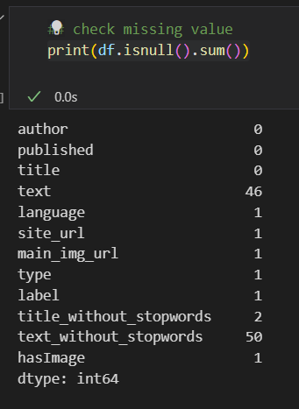
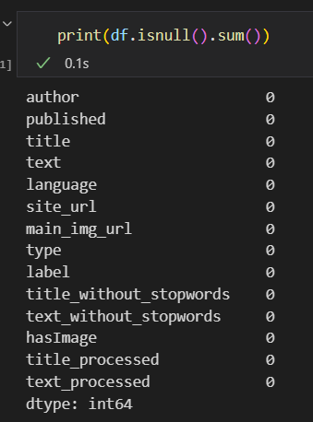

Data check

Slide 7
2.Exploratory analysis

Slide 8
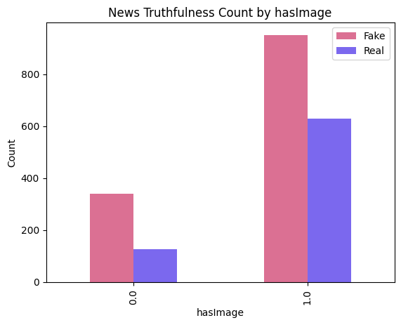
News Truthfulness Count by hasImage
The ratio of real news count was higher when news had images.
News is more likely to be true when publishing with images.

Slide 9
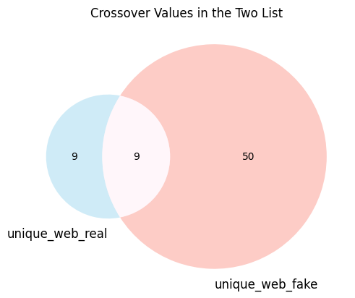
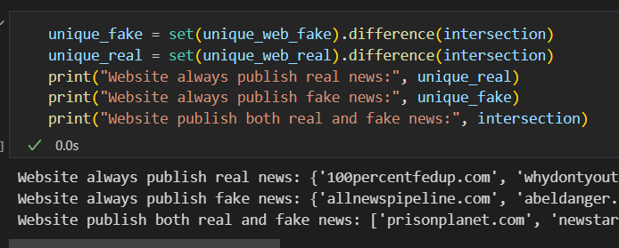
News Truthfulness Count by website
9 websites in the dataset always publish real news.
50 websites in the dataset always publish fake news.
9 websites in the dataset publish both fake and real news .

Slide 10

News Truthfulness Count by Types

Slide 11
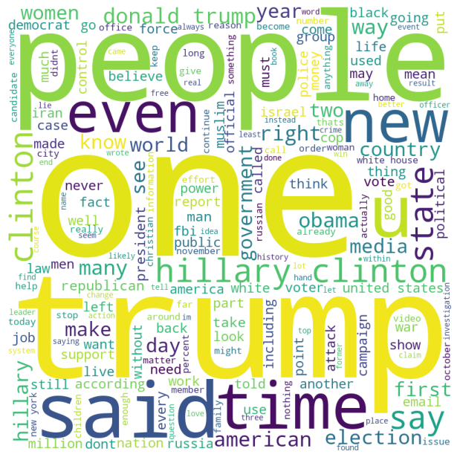
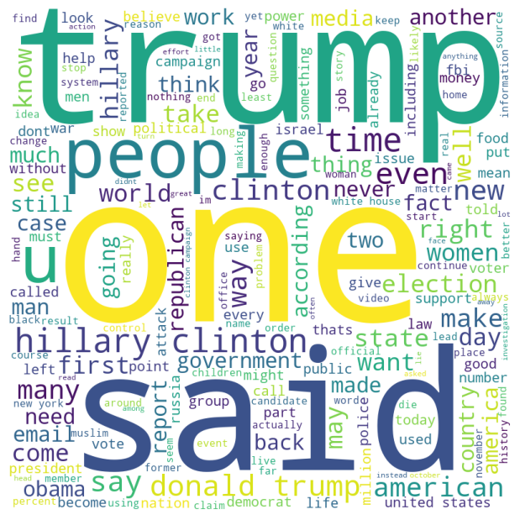
Word Cloud Image
Words appear most frequently in Real news
Words appear most frequently in fake news

Slide 12
3.Data pre-process

Slide 13
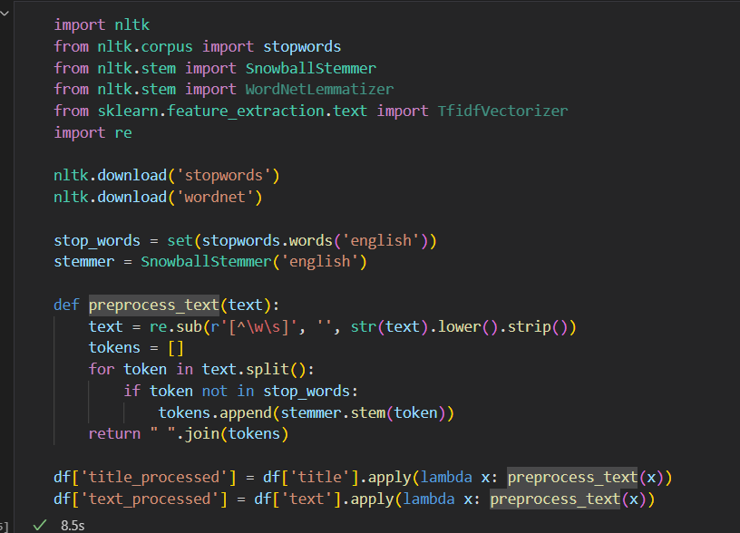
Natural language process
Stopword:
Words commonly occurring in a language, such as "the", "and", "a", etc., that are often filtered out in natural language processing (NLP) tasks
SnowballStemmer :
A powerful stemming algorithm that can stem words in multiple languages, including English, German, French, and more.
It uses a series of rules and heuristics to strip the suffixes from words to obtain their root form.

Slide 14
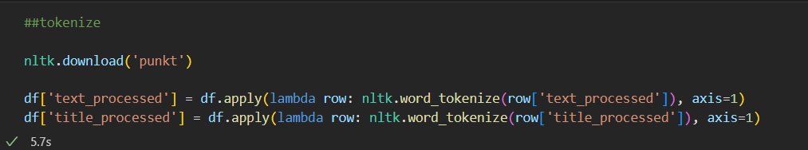
Natural language process
Tokenize:
Tokenization is the process of breaking down text into individual units called tokens.
The nltk.download('punkt') command is used to download the Punkt tokenizer from the NLTK library.

Slide 15
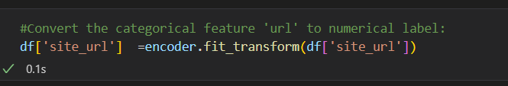
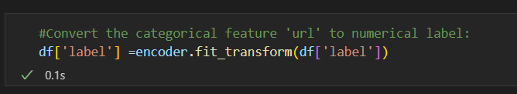
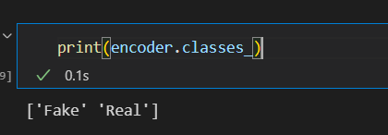
Convert other features to numeric data
In df[‘label’], 0 stands for fake, 1 stand for real

Slide 16
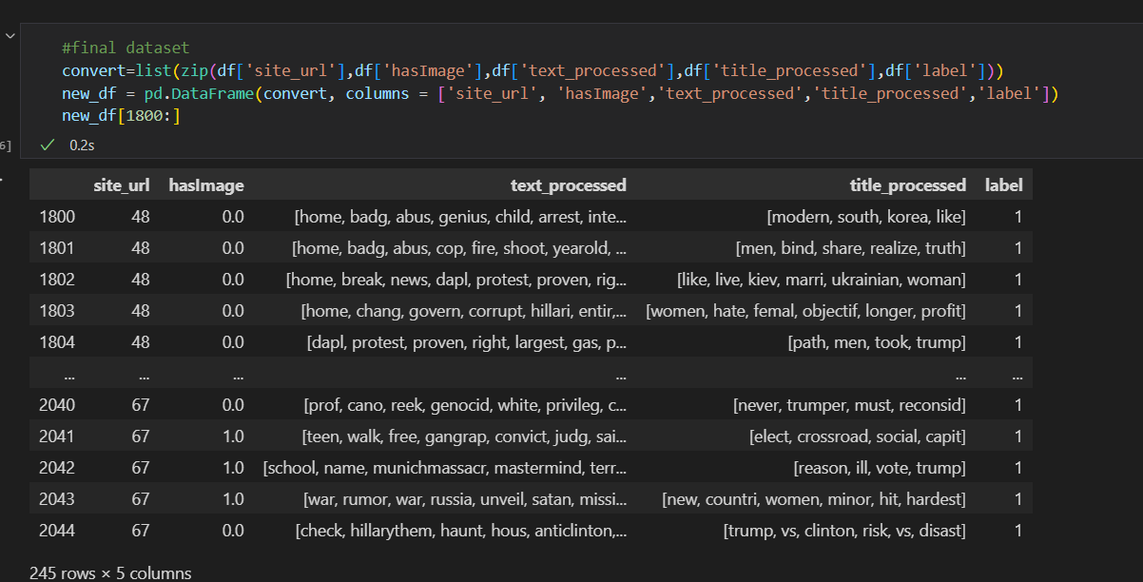
Final dateset

Slide 17
4.Ann model building

Slide 18
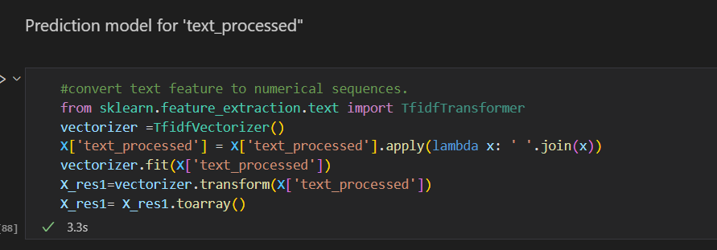
Prediction model for ‘text_processed’
TfidfVectorizer is a class in scikit-learn's feature_extraction module that is used for vectorizing text data into a matrix of TF-IDF features.

Slide 19
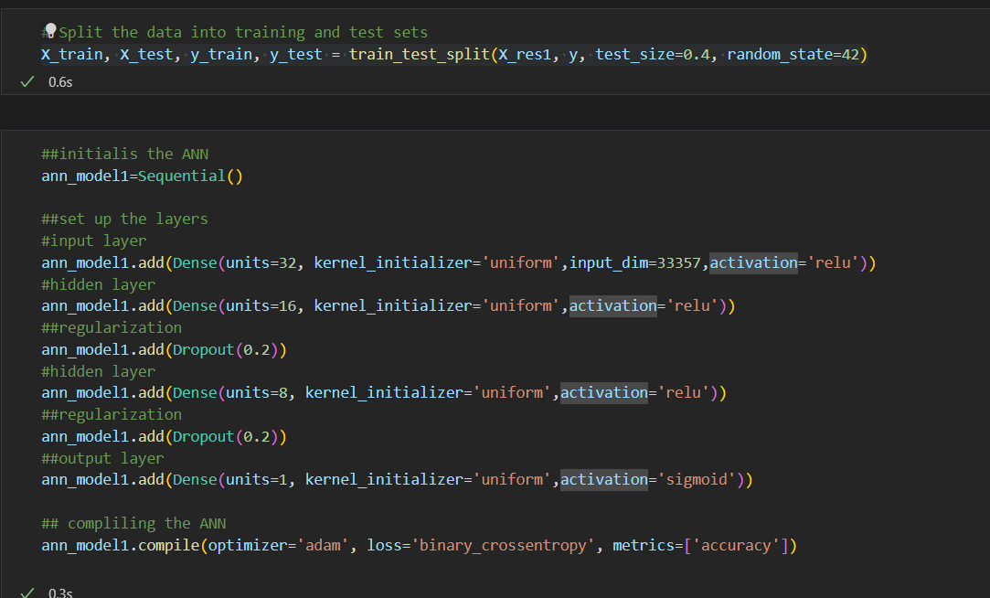

Slide 20
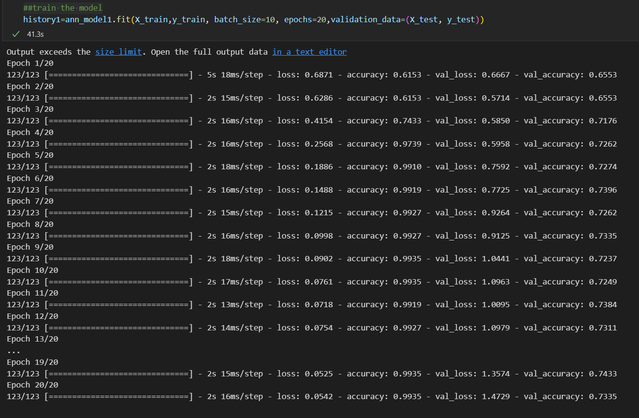
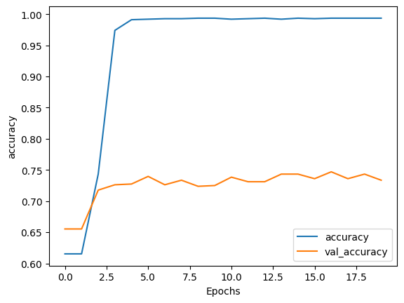
Accuracy of model 1

Slide 21
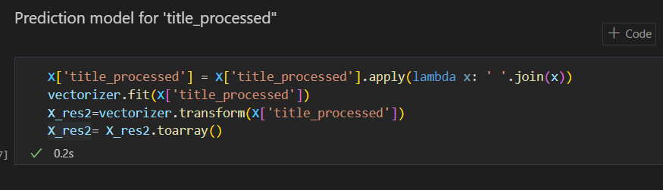
Prediction model for ‘title_processed’

Slide 22
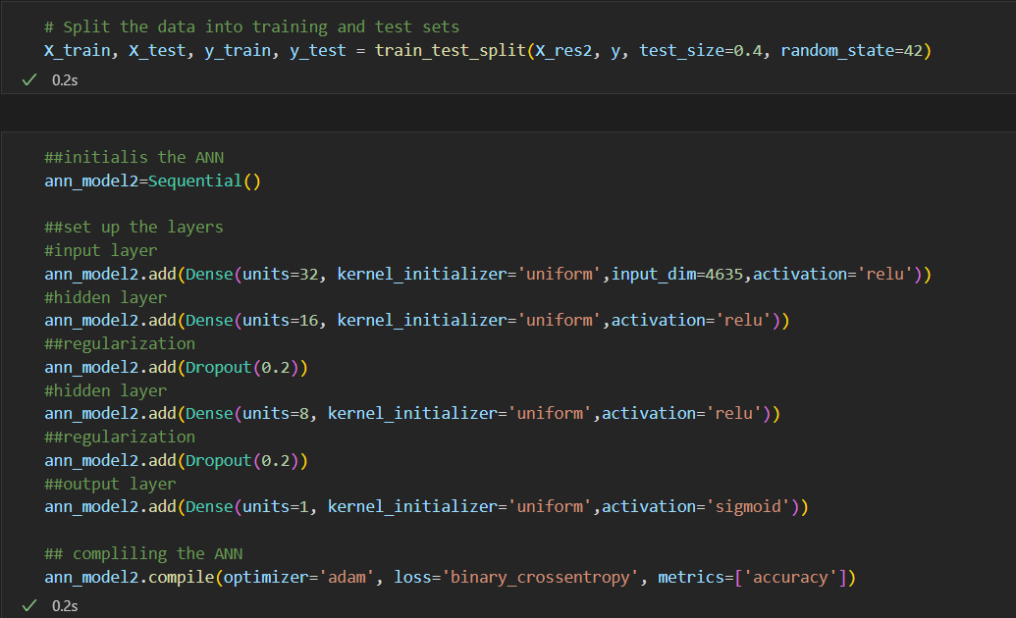

Slide 23
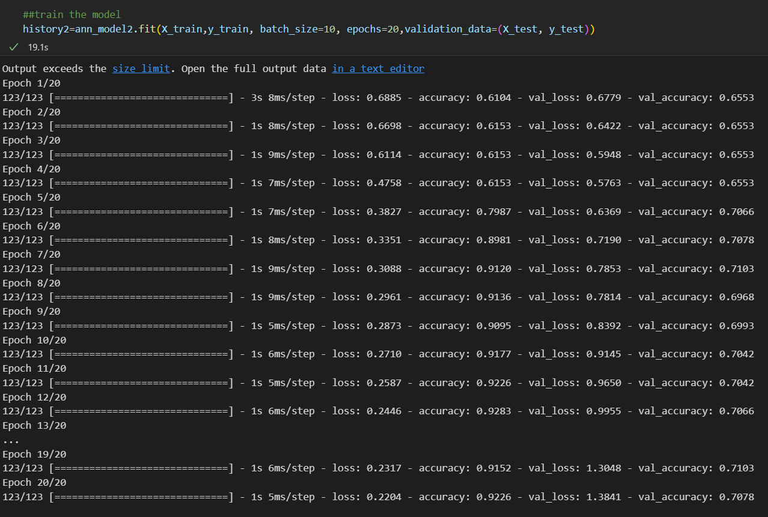
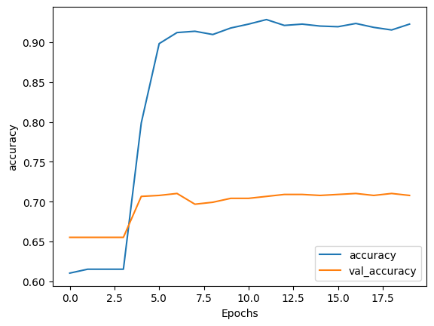
Accuracy of model 2

Slide 24
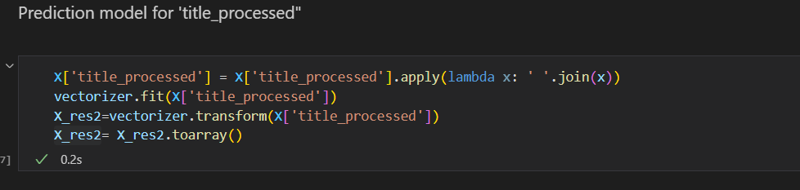
Prediction model for ‘ hasIage and url’

Slide 25
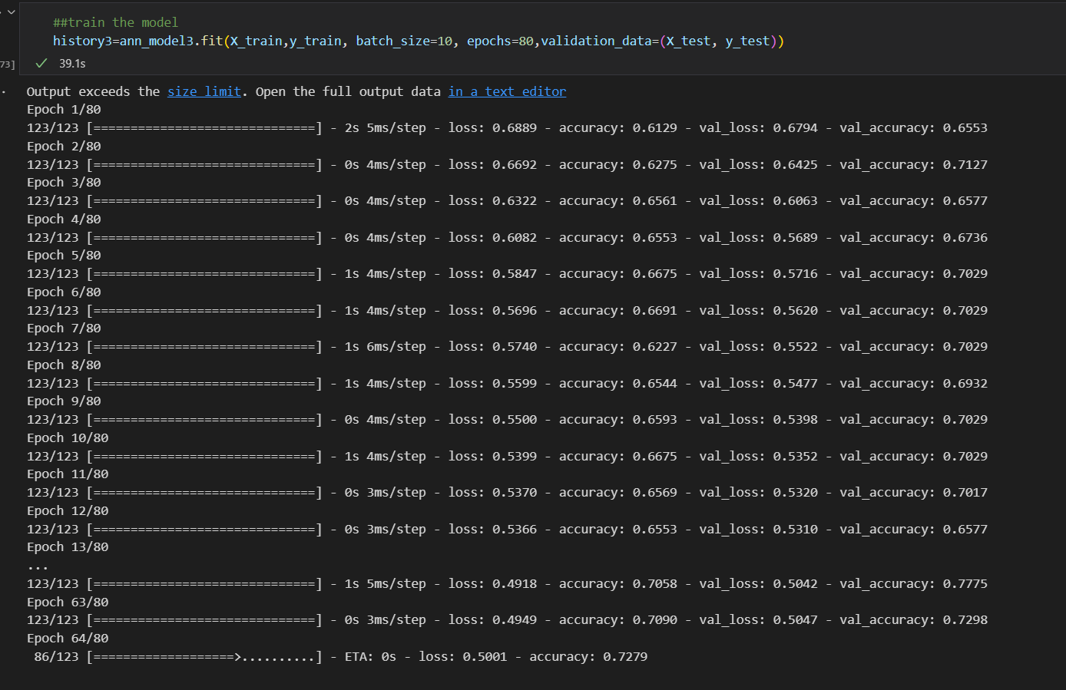
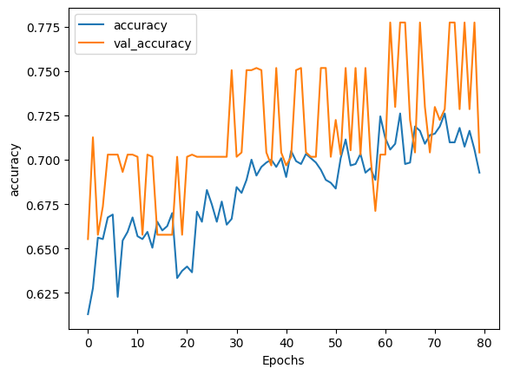
Prediction model for ‘ hasIage and url’

Slide 26
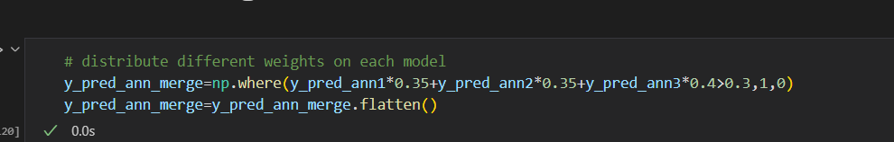
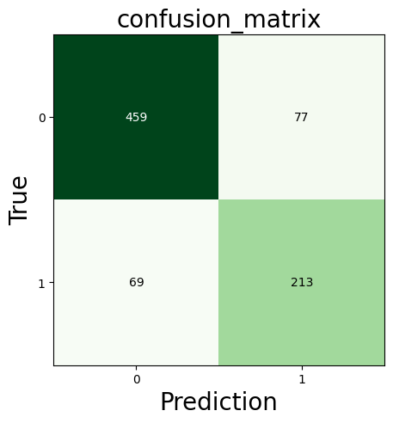
Merge Models
Allocate different weights on each model:
precision: 73.44827586206897
Recall: 75.53191489361703
Accuracy: 82.15158924205379

Slide 27
Further steps
Tuning hyperparameters to optimise the artificial intelligence model.
2. Deploy the data application as built-in plugins of websites.

